Slide 1
LC-MS data preprocessing

Slide 2
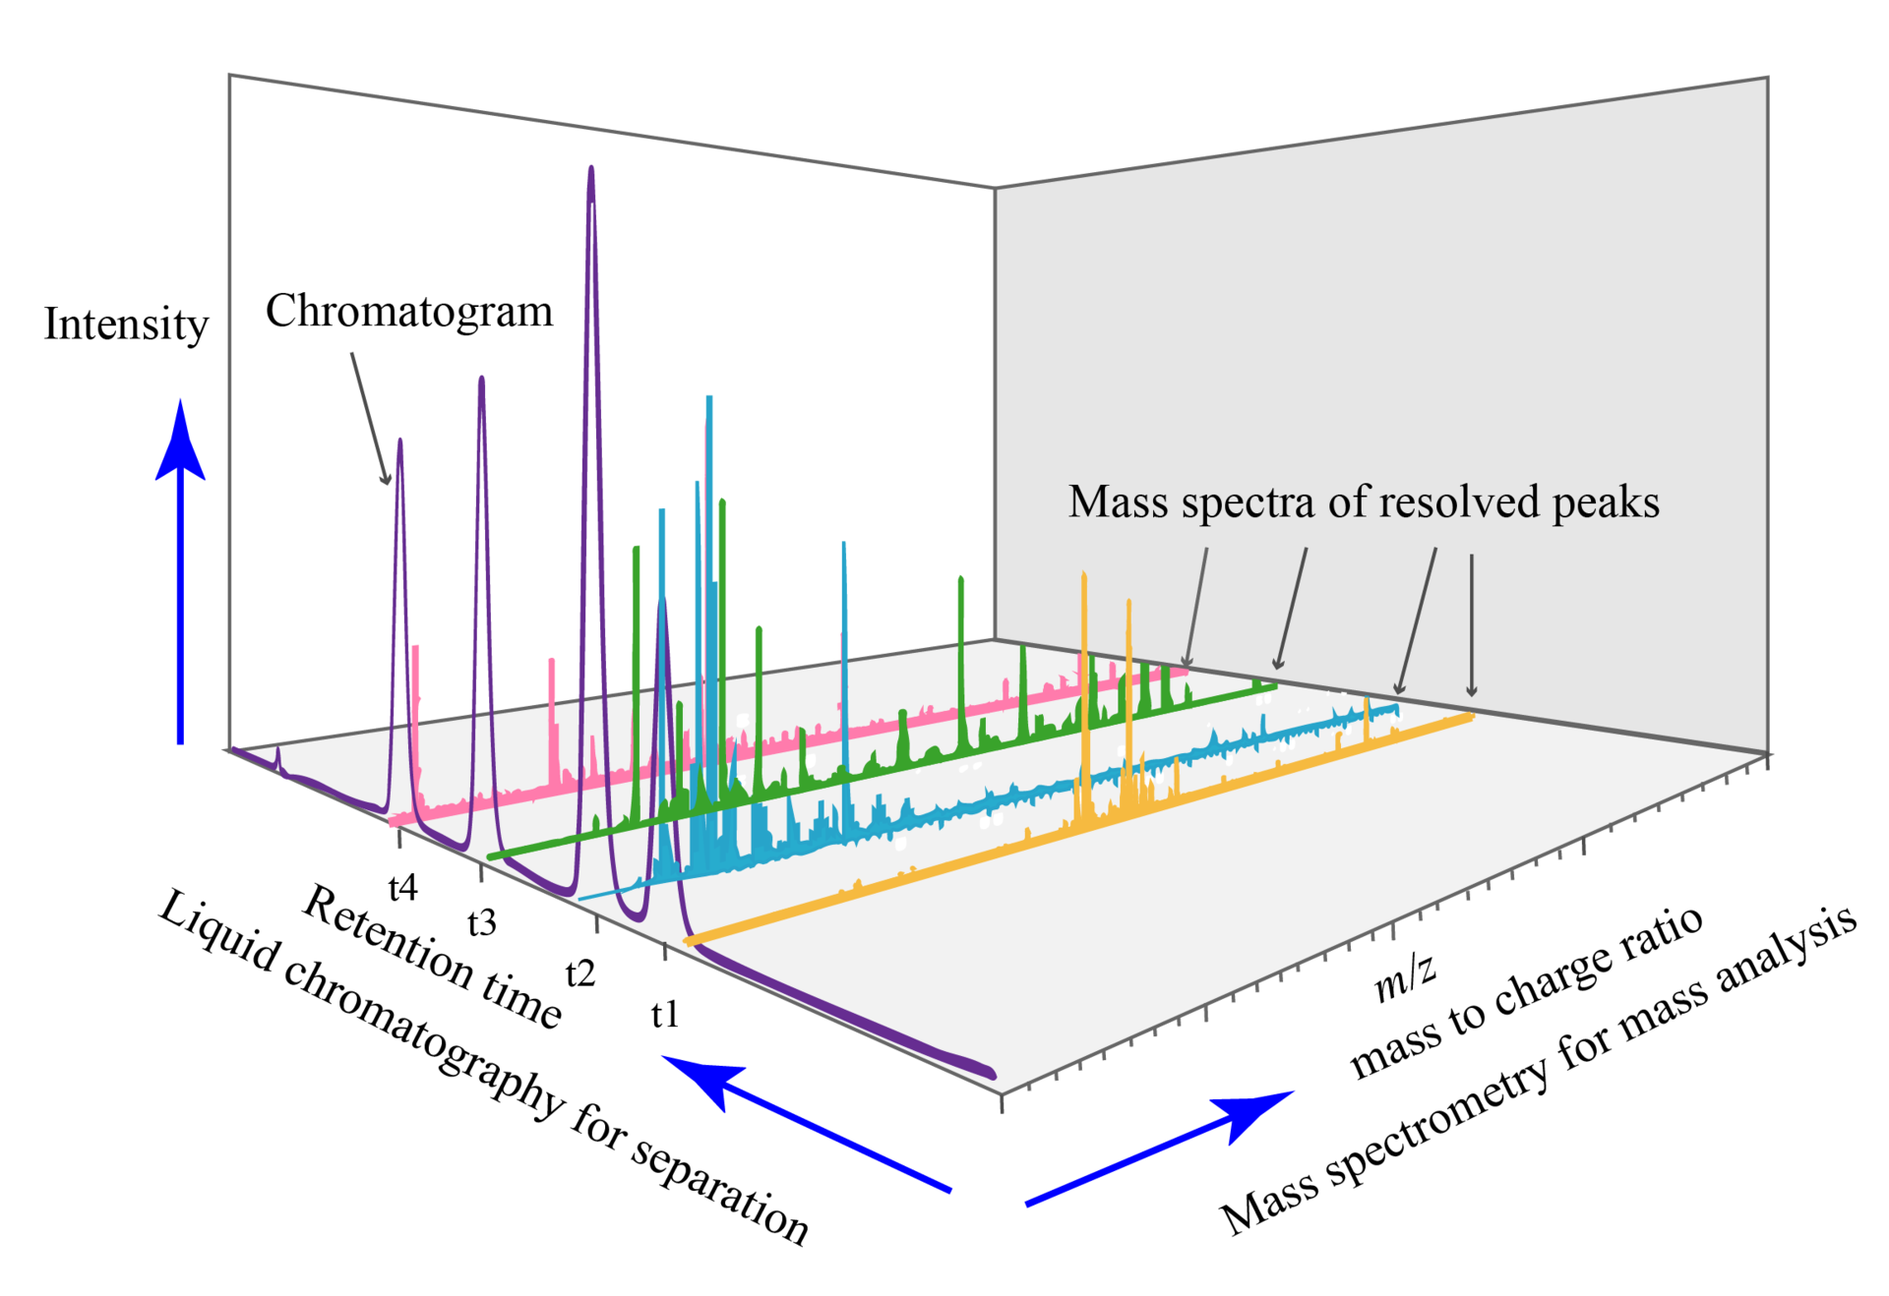
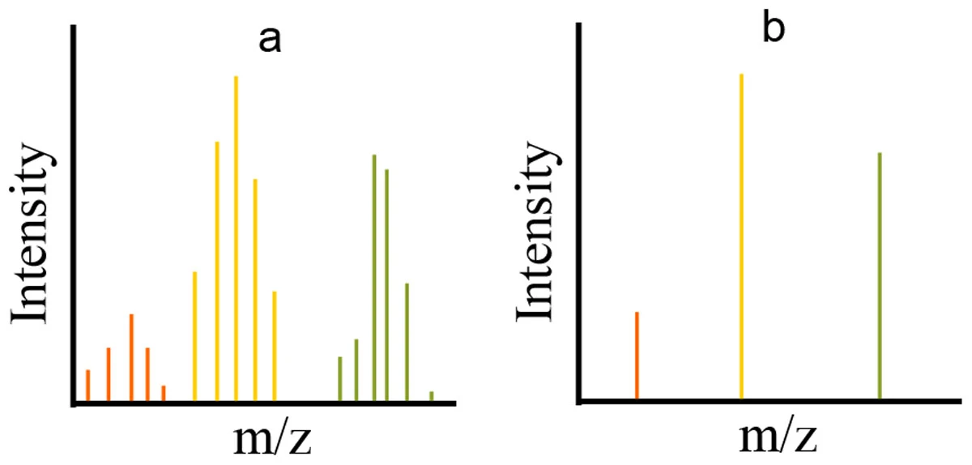
LC-MS data structure
A profile (a) and centroid (b) version of the same spectrum
Notes:
Fig 1 from: https://en.wikipedia.org/wiki/Liquid_chromatography%E2%80%93mass_spectrometry
Fig 2 from: https://bmcbioinformatics.biomedcentral.com/articles/10.1186/1471-2105-15-S7-S9

Slide 3
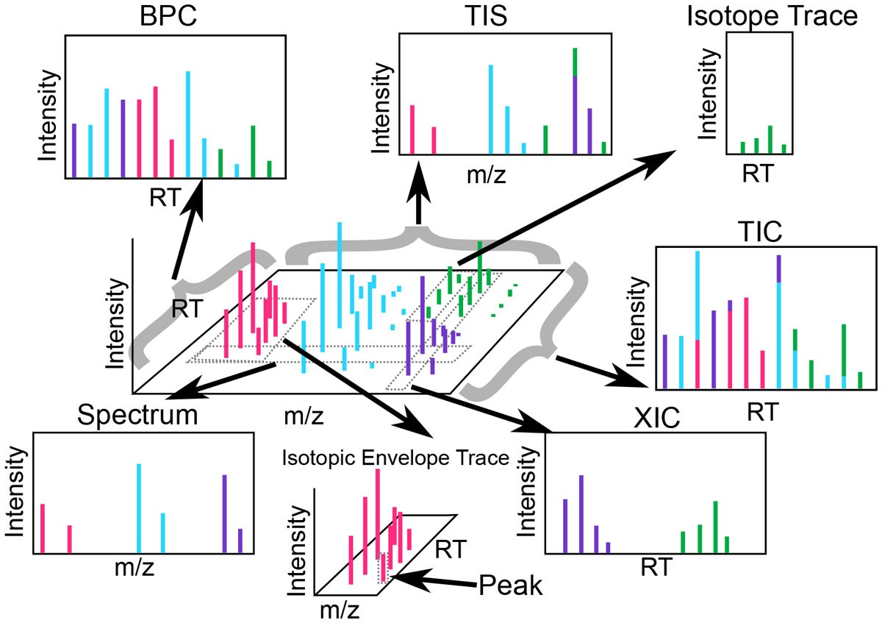
LC-MS data preprocessing
Peak detection
Chromatogram deconvolution
Alignment
Gap-filling
Identification
Notes:
Fig from: https://bmcbioinformatics.biomedcentral.com/articles/10.1186/1471-2105-15-S7-S9
Common nomenclature. Each portion or summary of an MS run is referred to by a different name. A spectrum contains all points with a single RT value. The sum of signals across all spectra is called the total ion spectrum (TIS). A slice of data containing a contiguous m/z range extending across all RT is called an extracted ion chromatogram (XIC). While the total ion chromatogram (TIC) is the sum of all signals across all m/z, the base peak chromatogram (BPC) is the set containing the most intense signal for each RT across all m/z. An isotope trace is the signal produced by a single ion of a single analyte (i.e., a peptide or a lipid) at a particular charge state. An isotopic envelope trace is the group of isotopic traces produced by a single analyte at a particular charge state. Note that certain terms like peak, feature, and chromatogram, are overloaded in the literature and as such are exceedingly unclear.

Slide 4
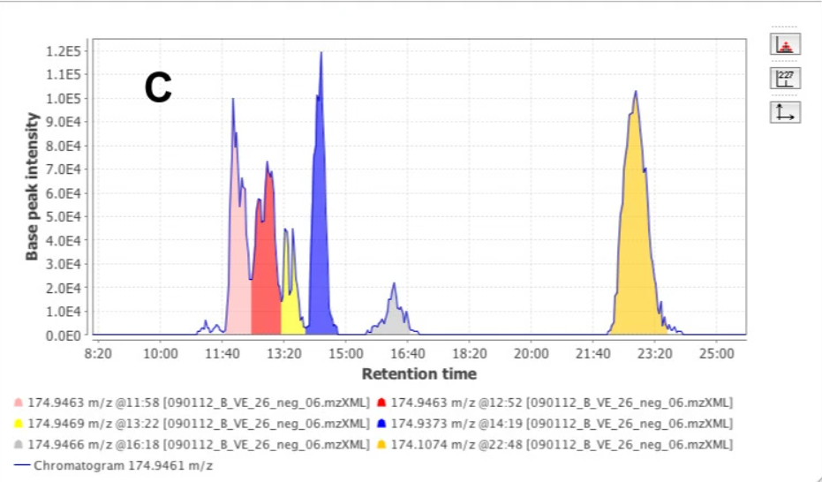

Slide 5
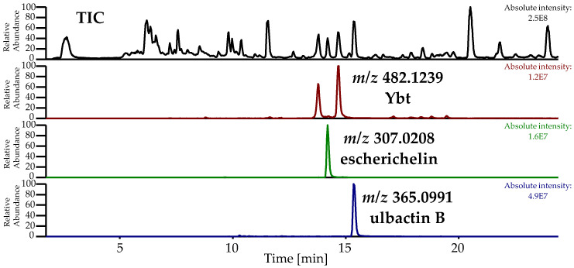
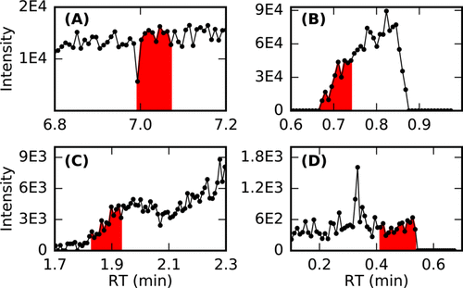
LC-MS data preprocessing
1) Peak detection (Build XIC)
False positive peaks
Notes:
Fig 1 from: https://www.mdpi.com/2218-1989/10/6/221
Fig 2 from: https://pubs.acs.org/doi/10.1021/acs.analchem.7b01069

Slide 6
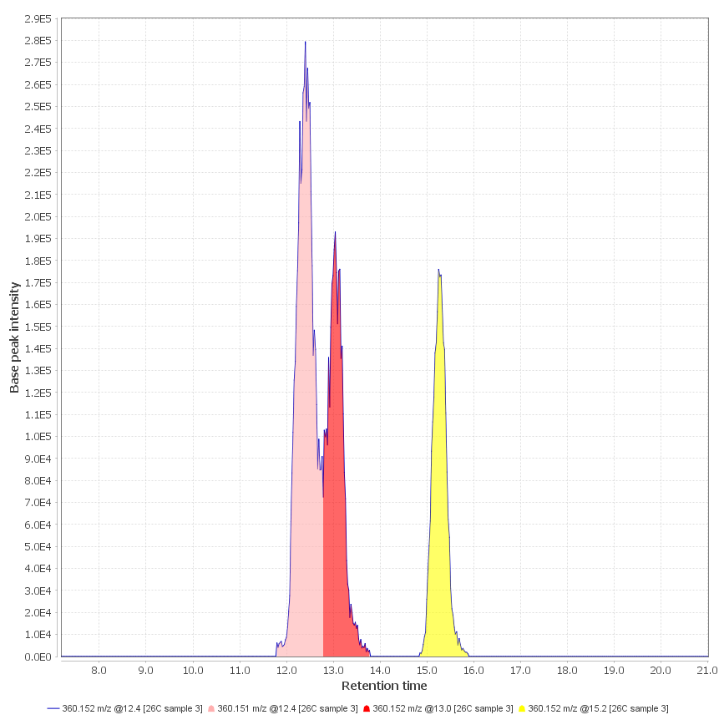
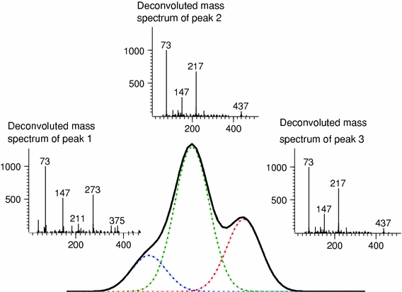
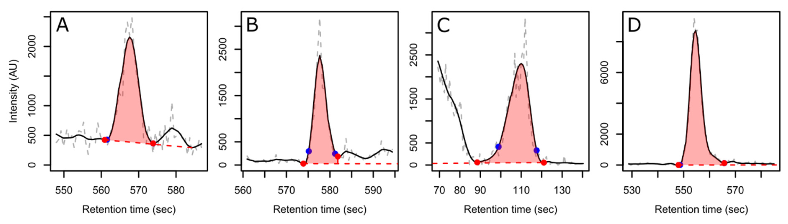
LC-MS data preprocessing
2) Chromatogram deconvolution
Co-eluting compounds
Estimates of peak boundaries
Notes:
Fig 1 from: http://mzmine.github.io/
Fig 2 from: https://pubmed.ncbi.nlm.nih.gov/21949491/
Fig 3 from: https://www.mdpi.com/2218-1989/12/2/137
Examples of retained peaks in the dataset selected at random from each quartile of the signal-to-noise ratio (A: S/N < 26.13, B: 26.13 ≤ S/N < 52.12, C: 52.12 ≤ S/N < 117.4, and D: 117.4 ≤ S/N). The raw ion trace is shown in dashed grey, the smoothed ion trace is in solid black, the detected baseline is in dashed red, and the detected peak boundaries are the red (CPC) or blue (XCMS) filled circles.

Slide 7
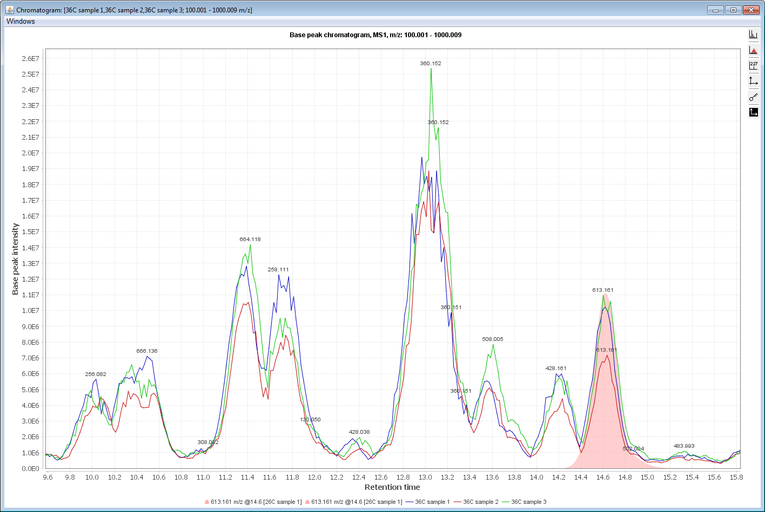
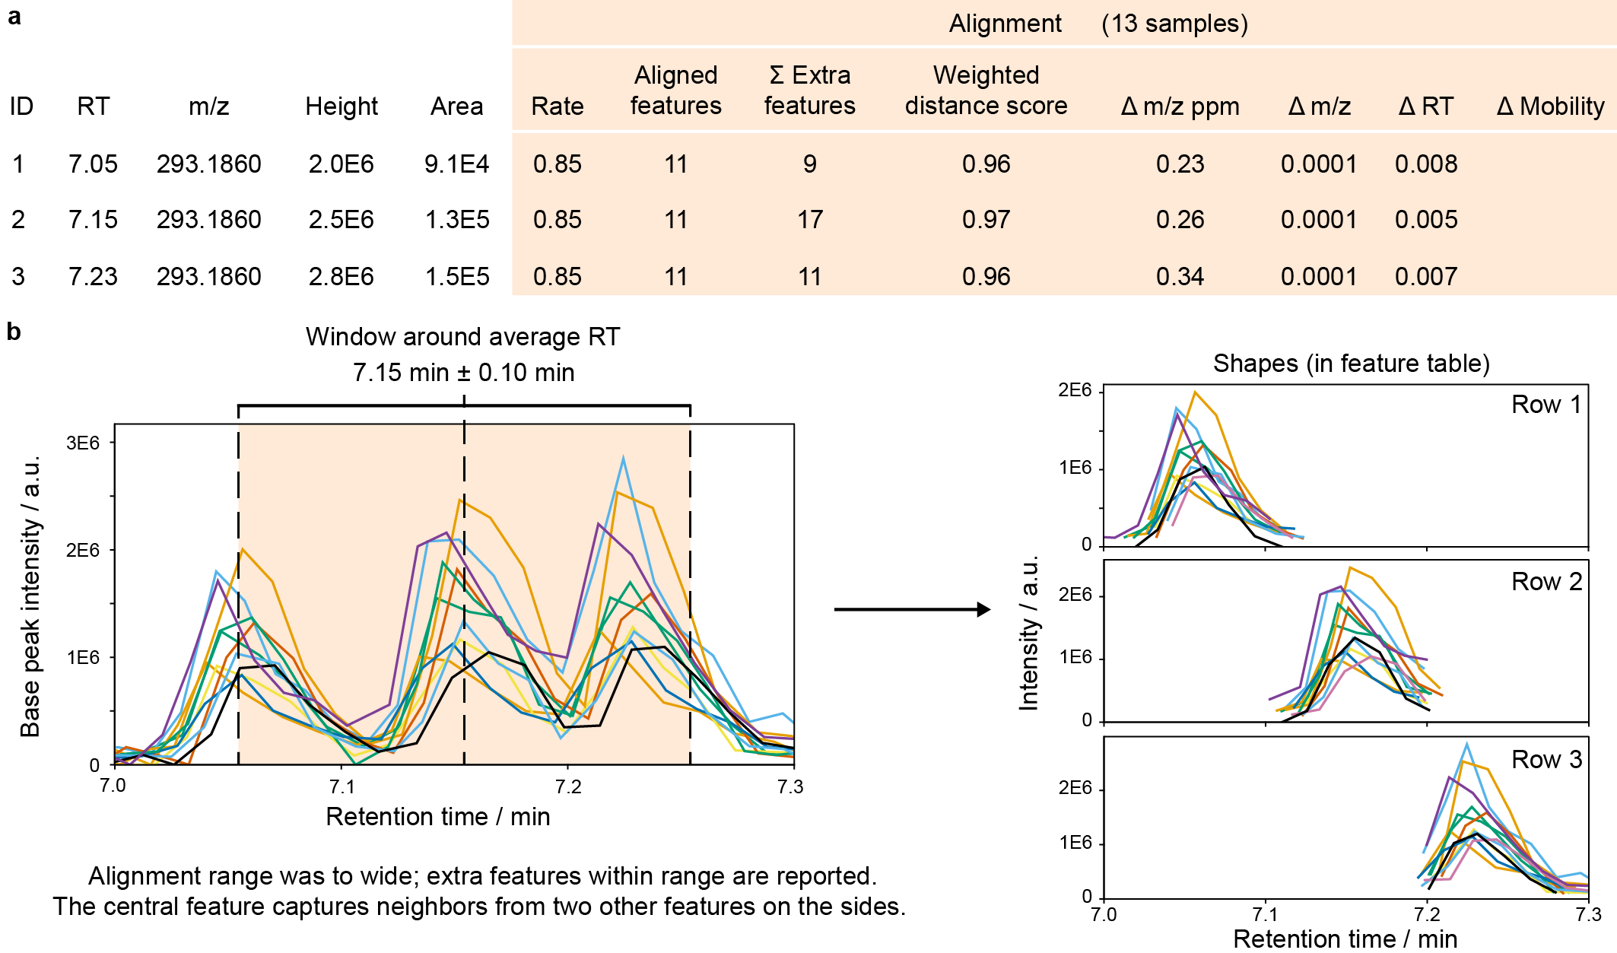
LC-MS data preprocessing
3) Alignment
Notes:
Fig 1 from: http://mzmine.github.io/
Fig 2 from: https://mzmine.github.io/mzmine_documentation/module_docs/align_join_aligner/join_aligner.html
The alignment columns in feature tables (MZmine 3.3.0). a, After alignment, new columns provide results on the alignment, including the alignment rate (aligned/total samples) and mean differences between all samples to the mean m/z, RT, and mobility. The weighted distance score reflects the alignment score, calculated for the final aligned feature. The summed extra features counts all additional features that were found within the m/z, RT, and mobility tolerances. b, Show the LC-MS EICs of 13 samples extracted with the alignment m/z tolerance around feature ID2. With a wide RT tolerance, 17 additional LC-MS features were found that indicate closely eluting isomers or other ions that might interfere with the alignment.

Slide 8
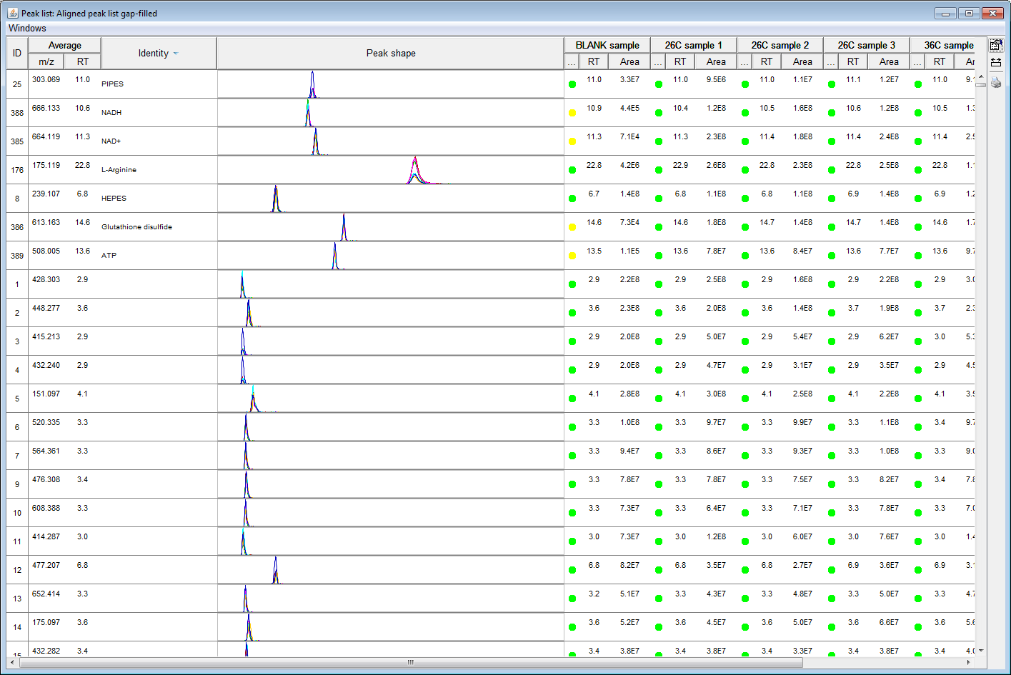
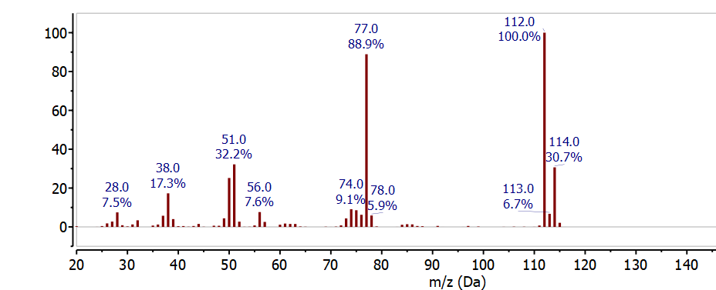
LC-MS data preprocessing
4) Gap filling, deisotope and other fitlers
Missing peaks:
Low peak intensity
Peak discarded in previous step
Misalignment
Inaccurate peak detection and deconvolution of co-eluting peaks
…
Mass Spectrum of chlorobenzene
Notes:
Fig 1 from: from: http://mzmine.github.io/
Fig 2 from: https://chem.libretexts.org/Bookshelves/Analytical_Chemistry/An_Introduction_to_Mass_Spectrometry_%28Van_Bramer%29/08%3A_INTERPRETATION/8.04%3A_Isotope_Abundance
The natural abundance of these two isotopes is observed in the mass spectrum as two peaks separated by 2 m/z with a relative intensity of 3:13:1. The mass spectrum of chlorobenzene C₆H₅Cl in Figure clearly shows the chlorine isotope distribution at 112 m/z and 114 m/z . These peaks correspond to the molecular ion - the molecular ion has the most abundant isotope for each element - at 112 m/z (6x12 + 5x1 + 35) and the ³⁷Cl isotope peak at 114 m/z (6x12 + 5x1 + 37) and the relative intensity is determined by the natural abundance of the ³⁷Cl isotope. The other major peak in this spectrum at 77 m/z corresponds to the loss of chlorine from the molecular ion or the ³⁷Cl isotope peak to give C₆H₅⁺ (112 - 35 = 77 OR 114 - 37 = 77).
Fig 2 from: http://mzmine.github.io/

Slide 9
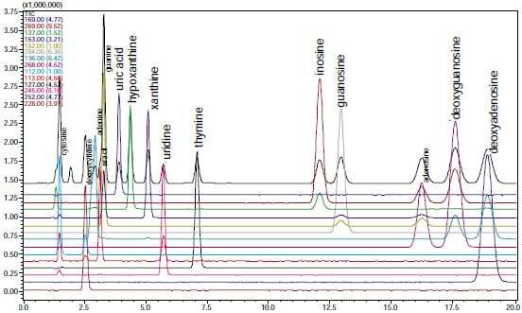
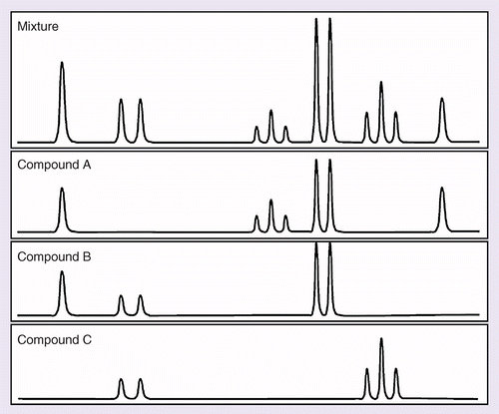
LC-MS data preprocessing
5) Identification – MS1
Chromatogram of Standard Mixture of Nucleic Acid Bases and Nucleotides
Notes:
Fig 1 from: https://www.shimadzu.com/an/industries/life-science/genomics-genetics/nucleic-acid-r/index.html
Fig 2 from: https://www.future-science.com/doi/10.4155/bio.09.138

Slide 10
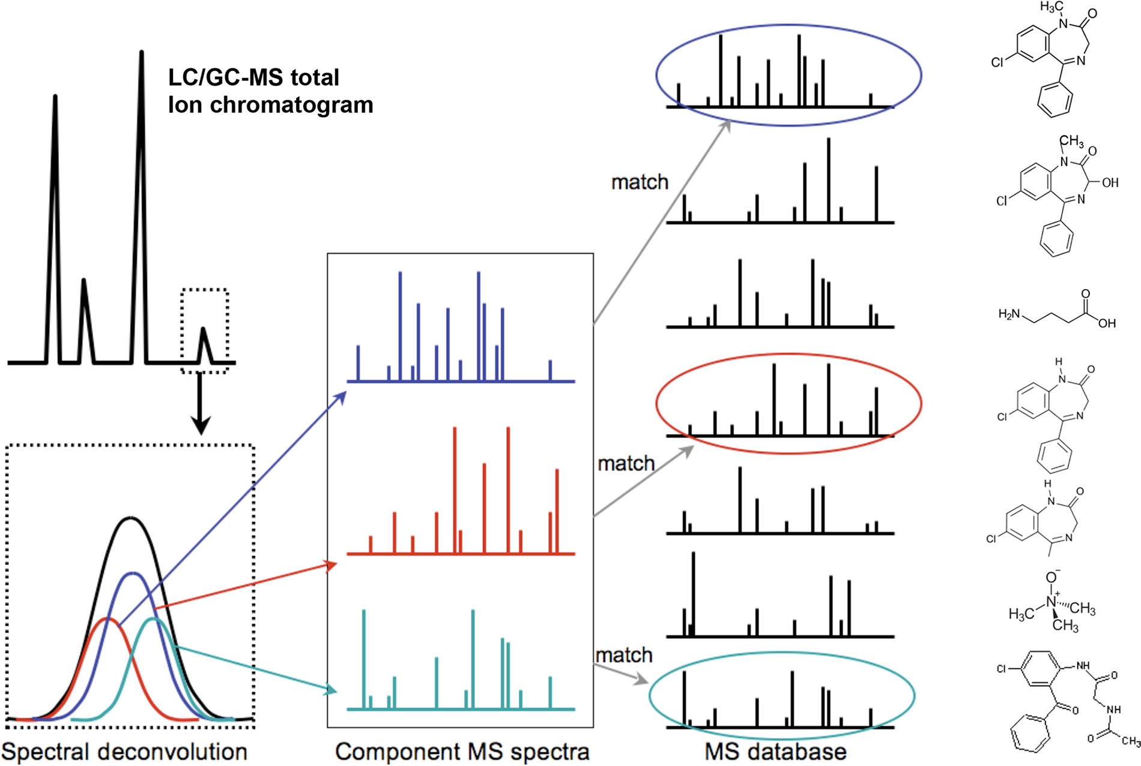
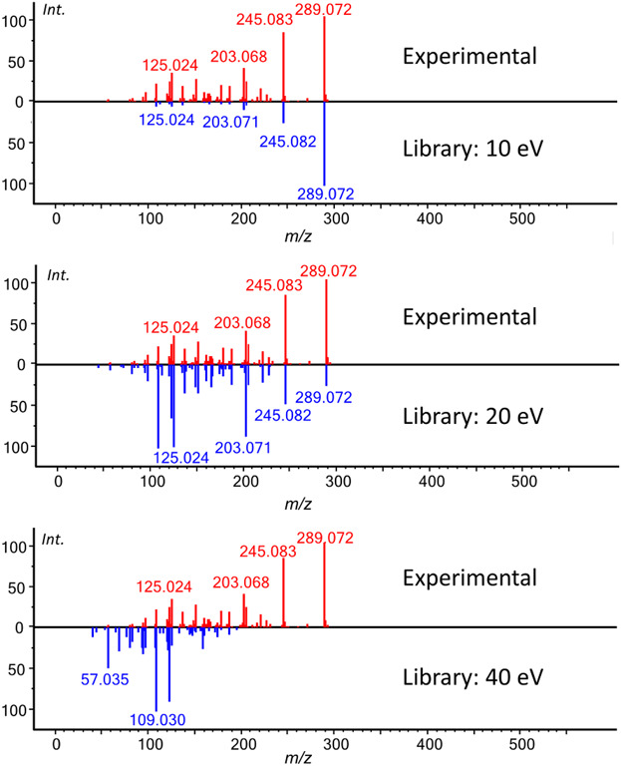
LC-MS data preprocessing
5) Identification – MS2
Notes:
Fig 1 from: https://journals.physiology.org/doi/full/10.1152/physrev.00035.2018
Fig 2 from: https://analyticalsciencejournals.onlinelibrary.wiley.com/doi/full/10.1002/mas.21535

Slide 11
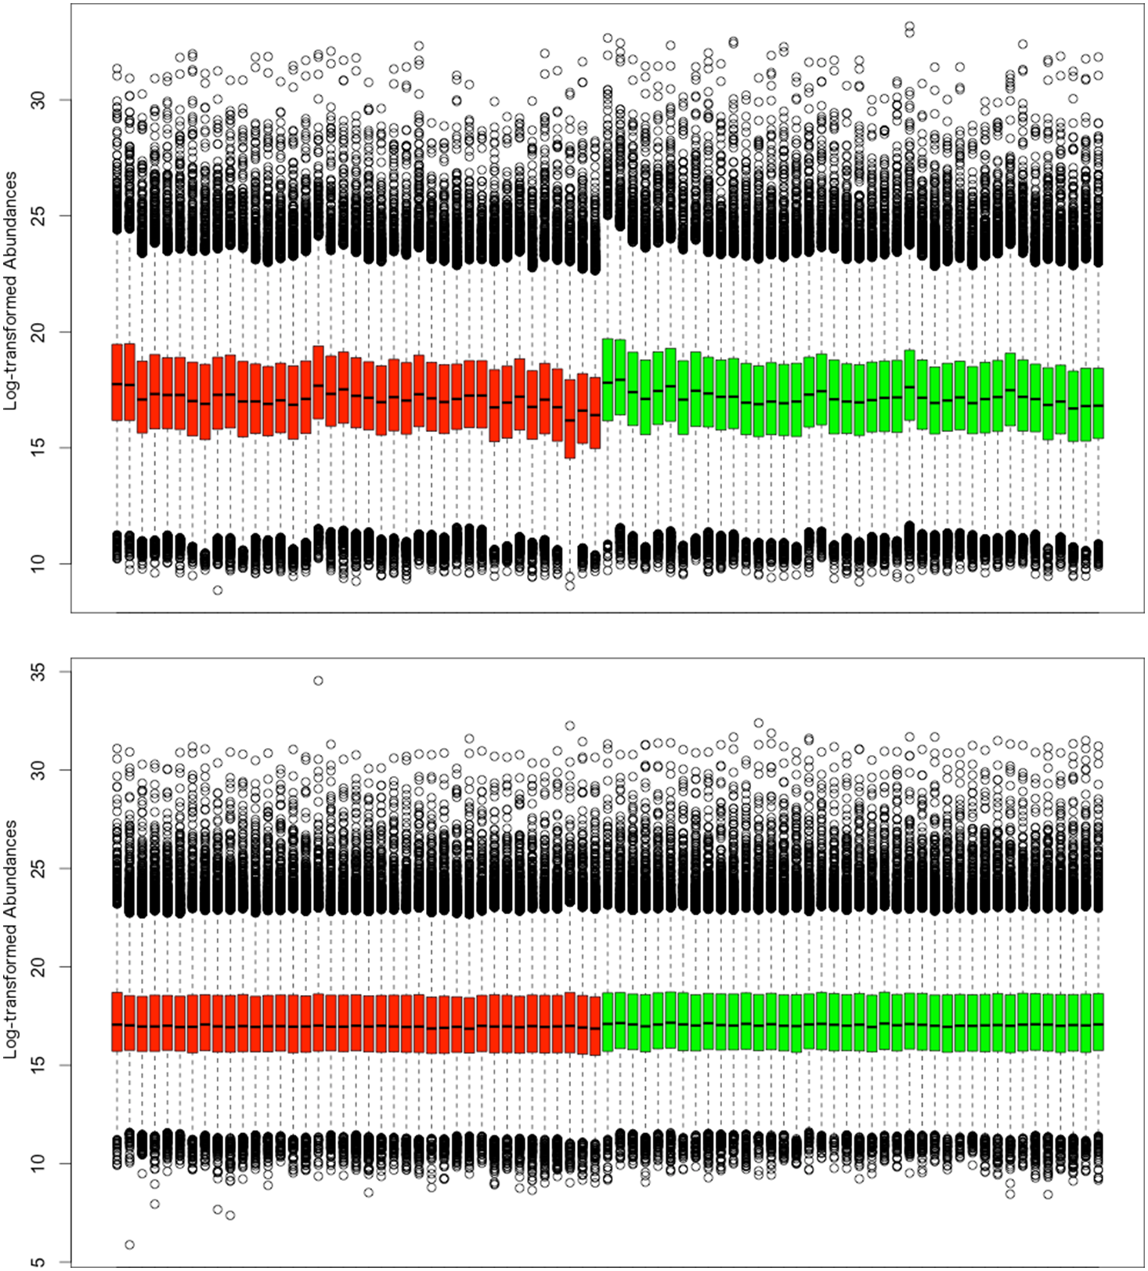
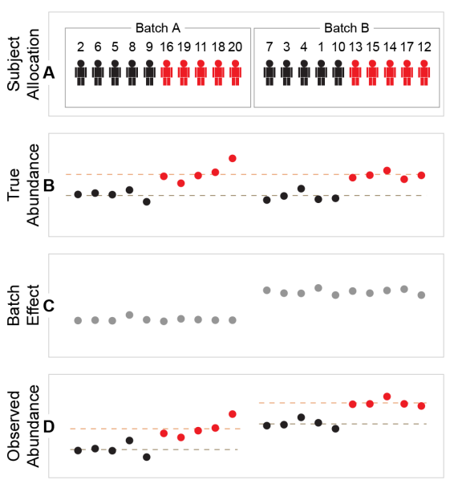
Normalization
Notes:
Fig 1 from: https://journals.plos.org/plosone/article?id=10.1371/journal.pone.0116221
Fig 2 from: https://pubs.acs.org/doi/10.1021/acs.jproteome.0c00536

